Slide 1
How to create a new Analytics Dashboard
Yoel Kortick
Senior Librarian

Slide 2
Introduction
Creating the dashboard
Editing the dashboard
Running the dashboard

Slide 3
Introduction
An analytics dashboard is useful because it brings together several reports into one common viewing area.
Typically the several reports in a dashboard all deal with the same topic, such as electronic resource usage, fulfillment statistics, or resource sharing requests.
There are a wide variety of features which can be added to dashboards. In the example here we will show how a basic dashboard can be made. Not every possibility will be pointed out.

Slide 4
Introduction
We will not be adding a prompt to the dashboard.
That is done in a separate presentation:
  How to create Dashboard Prompt

Slide 5
Introduction
In the example here we have a folder called “Physical Item Loans” and under it we have three subfolders:
Dashboards
Prompts
Reports

Slide 6
Introduction
Under the folder “Reports” we have three reports:
Most loaned LC classifications Group 1
Most loaned titles
Most returned overdue items
For the purposes of our presentation the nature of these reports is not important. What is important is that we want them all to appear in one dashboard, each in a separate page (tab) of the dashboard.
The folders “Dashboards” and “Prompts” are currently empty

Slide 7
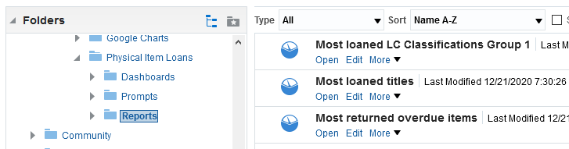
Introduction
Under the folder “Reports” we have three reports:

Slide 8
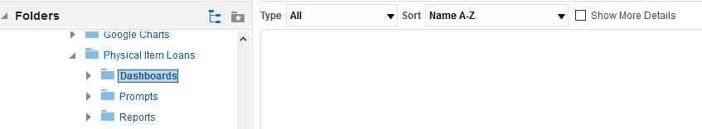
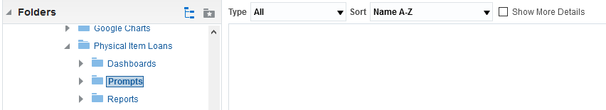
Introduction
The folders “Dashboards” and “Prompts” are currently empty

Slide 9
Creating the dashboard

Slide 10
Creating the dashboard
We will now
Create the dashboard via “New > Dashboards”
Save it in folder “Dashboards” under “Physical Item Loans”
Call it “Physical Item Loans Dashboard”

Slide 11
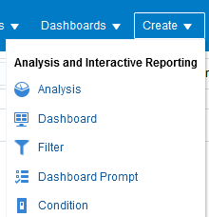
Creating the dashboard

Slide 12
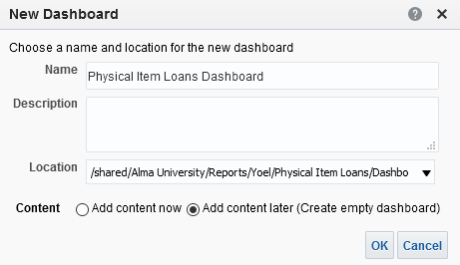
Creating the dashboard
Name
Location (we cannot see the full path here but it eventually points to “Physical Item Loans/Dashboards”)
We will add content to the dashboard soon

Slide 13
Editing the dashboard

Slide 14
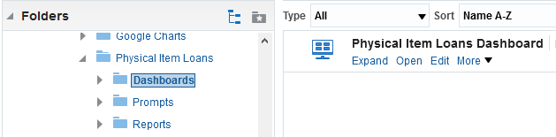
Editing the dashboard
Navigate to the dashboard and click “edit”

Slide 15
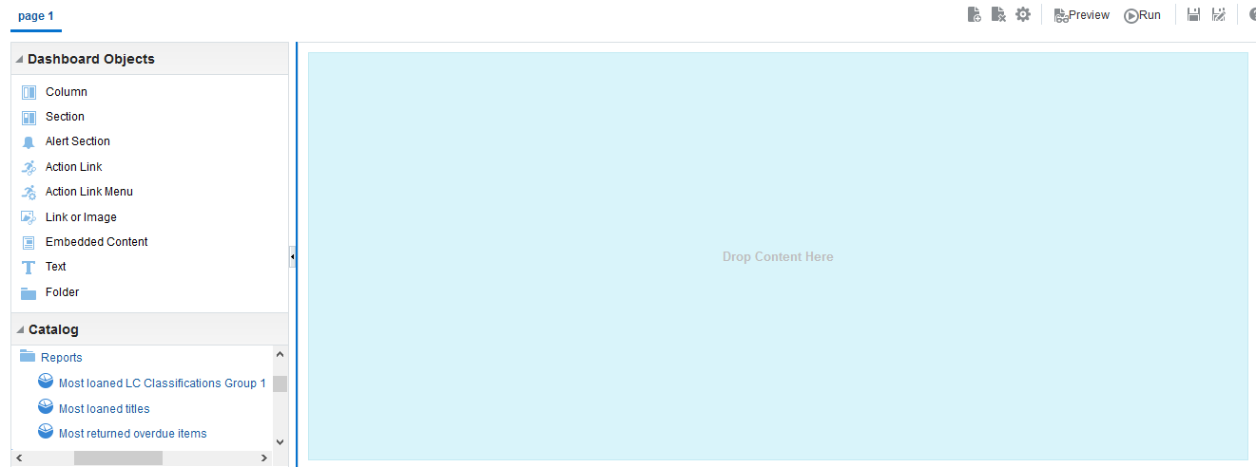
Editing the dashboard
By default we are at page 1 of the dashboard
Now we will drag the first report here
Here we have navigated to the reports which we want to add to the dashboard

Slide 16
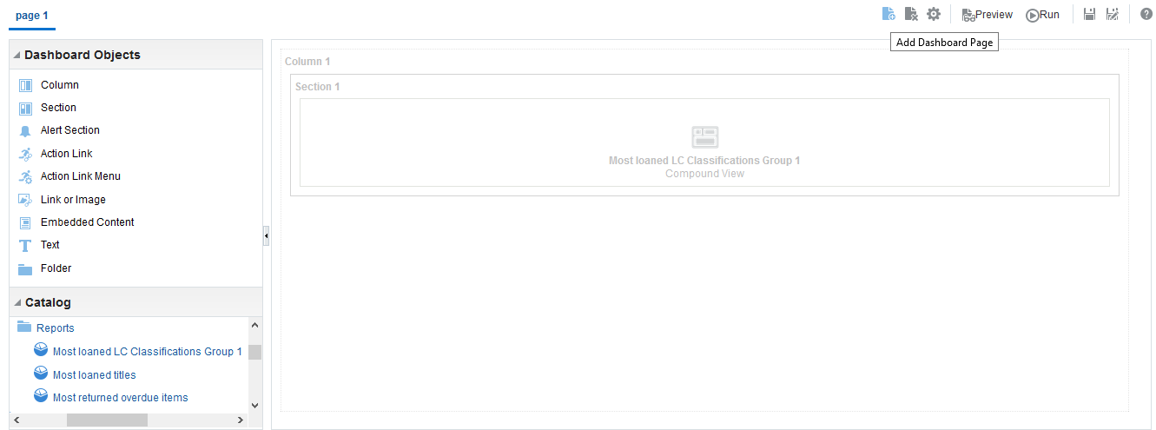
Editing the dashboard
We will add another page
Drag the report in

Slide 17
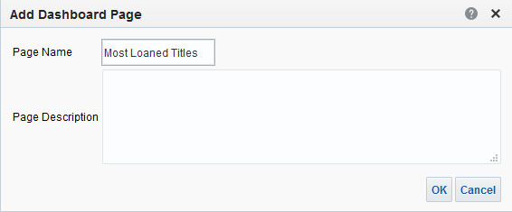
Editing the dashboard
We clicked “Add dashboard page” and we will call the new page “Most Loaned Titles”

Slide 18
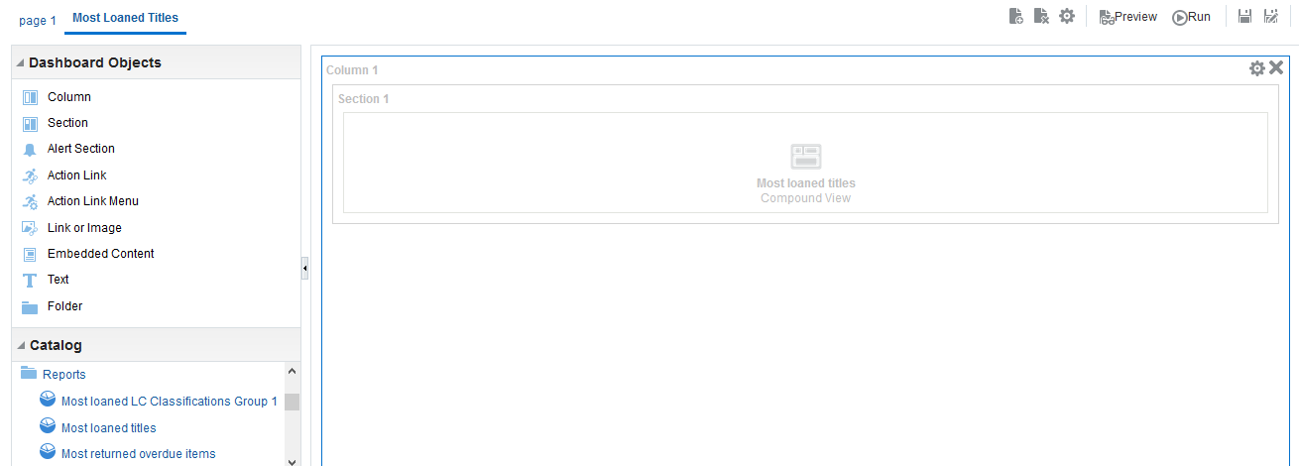
Editing the dashboard
The new page was created
We dragged in the report “Most loaned titles”

Slide 19

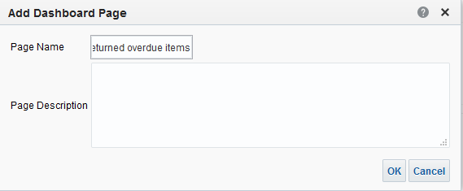
Editing the dashboard
Now we create another page called “Most returned overdue items”

Slide 20
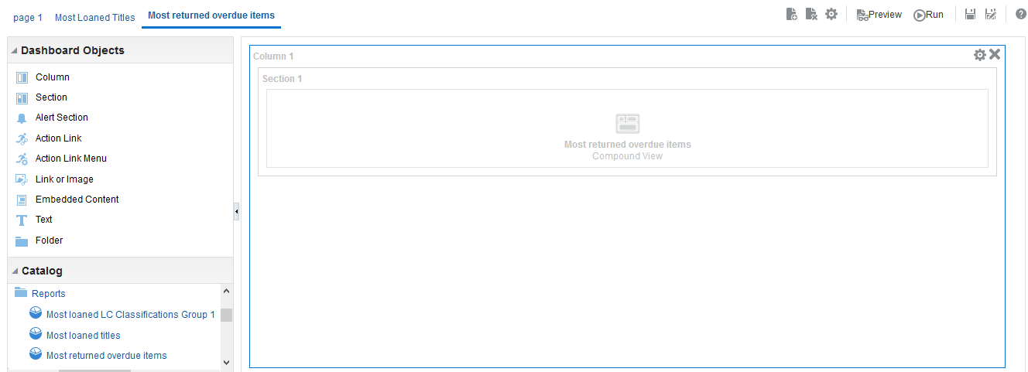
Editing the dashboard
The new page was created
We dragged in the report “Most returned overdue items”

Slide 21
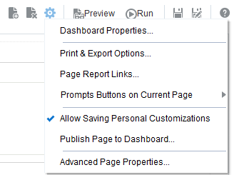
Editing the dashboard
Now we want to rename the default “Page 1” to “Most Loaned LC Classifications”
We will click “Tools” and then “Dashboard Properties”

Slide 22
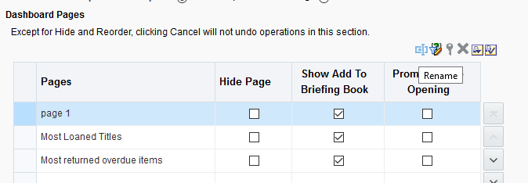
Editing the dashboard
After selecting the page click “Rename”
Select the page

Slide 23
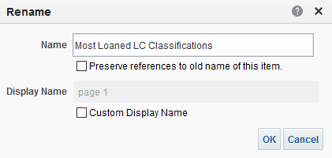
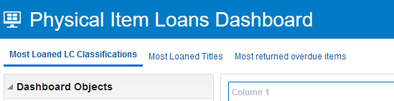
Editing the dashboard
The page is renamed

Slide 24
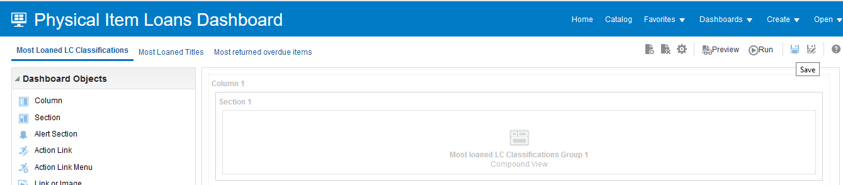
Editing the dashboard
Make sure of course to save the dashboard

Slide 25
Running the dashboard

Slide 26
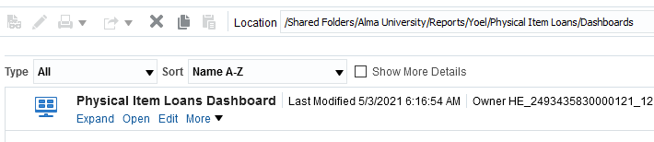
Running the dashboard
There are multiple ways to run a dashboard.
We will navigate to the dashboard and click “Open”

Slide 27
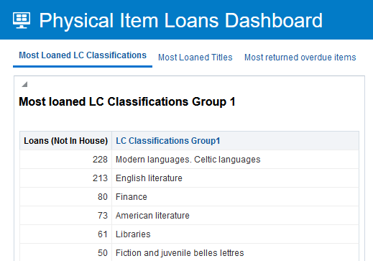
Running the dashboard
Here is page “Most Loaned LC Classifications” with the report we added to it

Slide 28
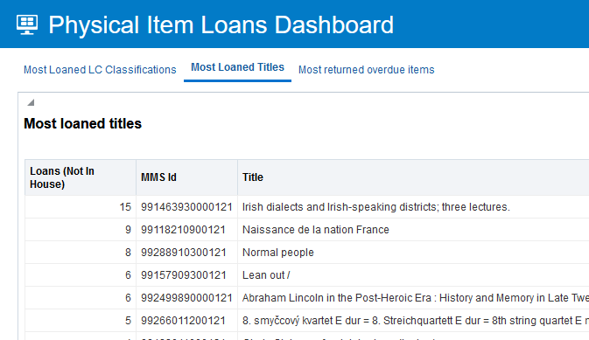
Running the dashboard
Here is page “Most Loaned Titles” with the report we added to it

Slide 29
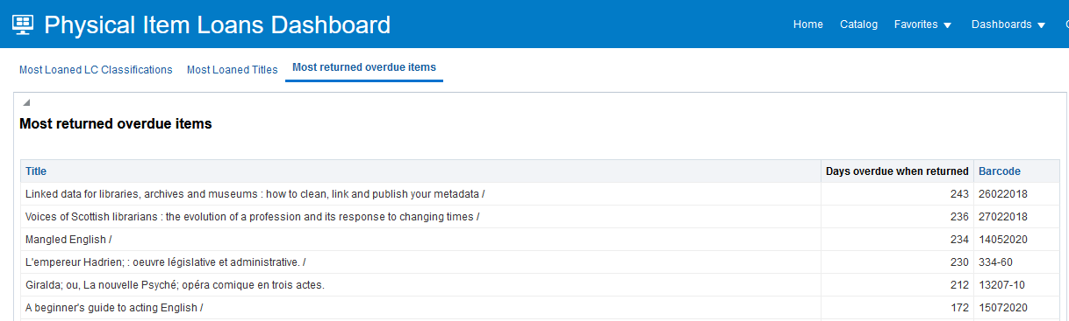
Running the dashboard
Here is page “Most Returned Overdue Items” with the report we added to it

Slide 30
Thank you!
xxx@exlibrisgroup.com

